Slide 1
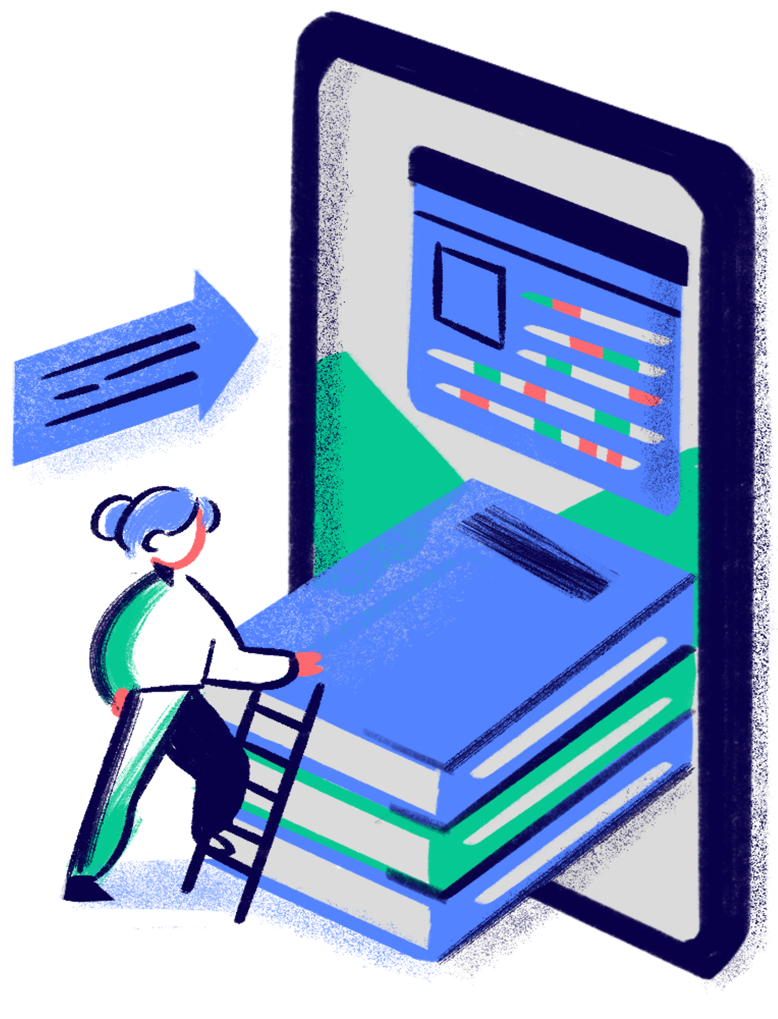

Encryption and Secure Communications
Ethan Wen

Slide 2
AGENDA
What is Cryptography?
Symmetric vs. Asymmetric Encryption
States of Data
TLS (transport layer) vs E2EE (end-to-end)
HTTPS
Full-Disk Encryption
Ransomware
Recommendations
Notes:
Note that throughout the presentation we will be referencing NIST and CISA, and give a quick reference to what they are

Slide 3

Cryptography
Process of converting information in a way that only intended recipients can access it
I LOVE CYBER
(Plaintext)
M PSZI GCFIV
(Ciphertext)
Caesar Cipher
Hello!
(Plaintext)
Encryption
8e59d66f8aa0b3a9566f60c9b62f2cba
(Ciphertext)
8e59d66f8aa0b3a9566f60c9b62f2cba
(Ciphertext)
Decryption
Hello!
(Plaintext)
(Chapple & Seidl, 2021)
Notes:
Confidentiality – protecting your information from unauthorized access: In the case of SOA, what would happen if customer login credentials like passwords, usernames or credit card info were stolen? Loses customer trust
Integrity – protecting your information from unauthorized modification: What would happen if Payroll information was changed? Safeguarding sensitive information
Availability – preventing any business disruption in how you're accessing information in a timely manner. What if your customers couldn’t access you? What if you can't access customers banking information? Disruption

Slide 4
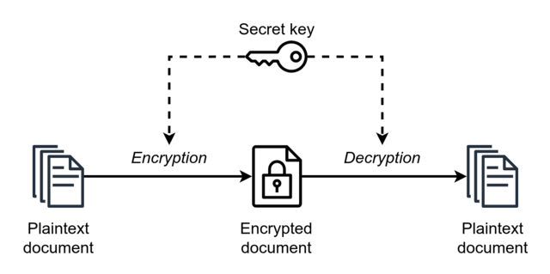
Symmetric Encryption
Also known as Shared Secret Encryption or Private Key Encryption
Uses the same key for encryption and decryption
Data Encryption Standard, 3DES, AES
Pros:
Faster than asymmetric (1000 – 10,000)
Efficient in computation and storage
Simplistic yet strong
Cons:
Messages compromised if key is
Not scalable (hard for large groups)
No non-repudiation (can’t prove origin)
Number of Participants | Symmetric Keys Required | Asymmetric Keys Required
2 | 1 | 4
3 | 3 | 6
4 | 6 | 8
5 | 10 | 10
10 | 45 | 20
100 | 4950 | 200
1000 | 499,500 | 2000
(Chapple & Seidl, 2021)
Notes:
The point of this, the message we are trying to get across and the work we have been doing with SOA is to reinforce the idea that the most basic of cybersecurity and defense doesn’t have to be difficult. Information security has often been seen as an IT department type of issue, and the common misconception is if you don’t even have an IT department, you must not be important enough to be attacked.
And then the importance of cybersecurity doesn’t come up until an attack actually occurs. Which goes for a lot of other things like adopting healthy lifestyle habits until you go to the doctor and get some bad news.
Why attack a small business? More to lose, less resources on hand, responding is costly and causes major business disruptions

Slide 5
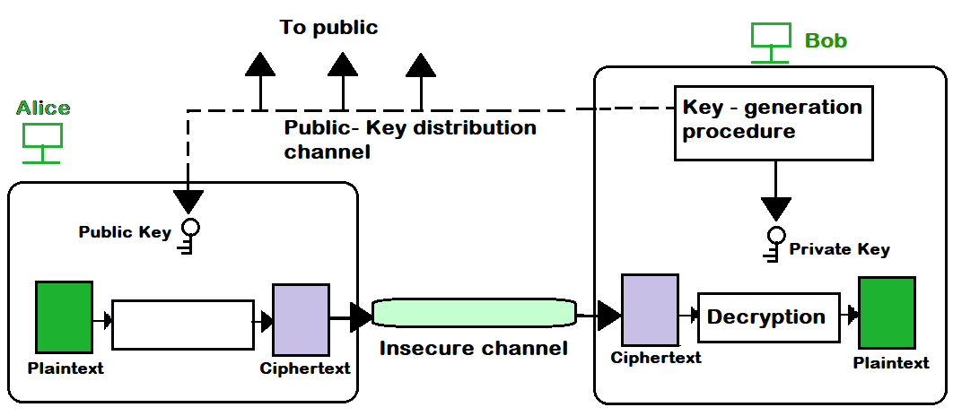

Asymmetric Encryption
Also known as Public Key Encryption
Each user has a public and private key.
RSA, Elliptic Curve, Diffie-Hellman
Pros:
No need to exchange key
Non-repudiation
Scalability
Cons:
Slower
Inefficient for large amounts of data
Complex
Encryption
Decryption
Hash
= ?
Hash
Bob’s Private Key
Bob’s Public Key
----------------------------------------------------
Encryption
----------------------------------------------------
Decryption
----------------------------------------------------
Bob
Alice
Alice’s Public Key
Alice’s Private Key
(Chapple & Seidl, 2021)
Notes:
The point of this, the message we are trying to get across and the work we have been doing with SOA is to reinforce the idea that the most basic of cybersecurity and defense doesn’t have to be difficult. Information security has often been seen as an IT department type of issue, and the common misconception is if you don’t even have an IT department, you must not be important enough to be attacked.
And then the importance of cybersecurity doesn’t come up until an attack actually occurs. Which goes for a lot of other things like adopting healthy lifestyle habits until you go to the doctor and get some bad news.
Why attack a small business? More to lose, less resources on hand, responding is costly and causes major business disruptions

Slide 6



States of Data
Data At Rest
Stored data on hard drives, SSDs, USBs, cloud storage
Ex: A file stored on Google Drive
Data in Transit
Transmitted data across a network between two or more systems
Ex: Sending an email message to your friend
Data in Use
Data that is stored in active memory/currently being used
Ex: Typing this up on PowerPoint
(Chapple & Seidl, 2021)

Slide 7
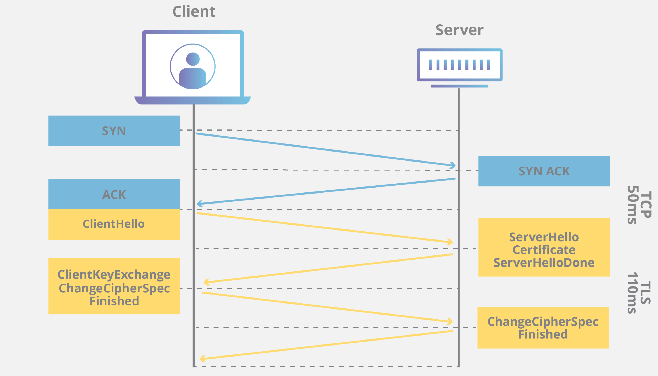
Transport Layer Security (TLS) Handshake
(Cloudflare)
Notes:
The point of this, the message we are trying to get across and the work we have been doing with SOA is to reinforce the idea that the most basic of cybersecurity and defense doesn’t have to be difficult. Information security has often been seen as an IT department type of issue, and the common misconception is if you don’t even have an IT department, you must not be important enough to be attacked.
And then the importance of cybersecurity doesn’t come up until an attack actually occurs. Which goes for a lot of other things like adopting healthy lifestyle habits until you go to the doctor and get some bad news.
Why attack a small business? More to lose, less resources on hand, responding is costly and causes major business disruptions

Slide 8


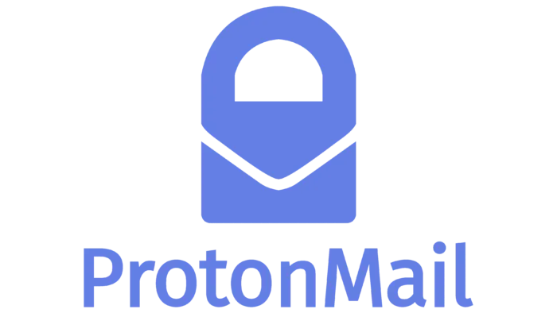



TLS vs. E2EE (end-to-end)
Ex: Sending email through Gmail
Subpoena/Search Warrant
Google’s email server
ProtonMail’s server
Decryption
Encryption
Encrypted Throughout
----------------------------------------------------
----------------------------------------------------
Encryption
Decryption
Encryption
Decryption
Alice
Bob
Alice
Bob
(Electronic Frontier Foundation, 2018)
Notes:
The point of this, the message we are trying to get across and the work we have been doing with SOA is to reinforce the idea that the most basic of cybersecurity and defense doesn’t have to be difficult. Information security has often been seen as an IT department type of issue, and the common misconception is if you don’t even have an IT department, you must not be important enough to be attacked.
And then the importance of cybersecurity doesn’t come up until an attack actually occurs. Which goes for a lot of other things like adopting healthy lifestyle habits until you go to the doctor and get some bad news.
Why attack a small business? More to lose, less resources on hand, responding is costly and causes major business disruptions

Slide 9
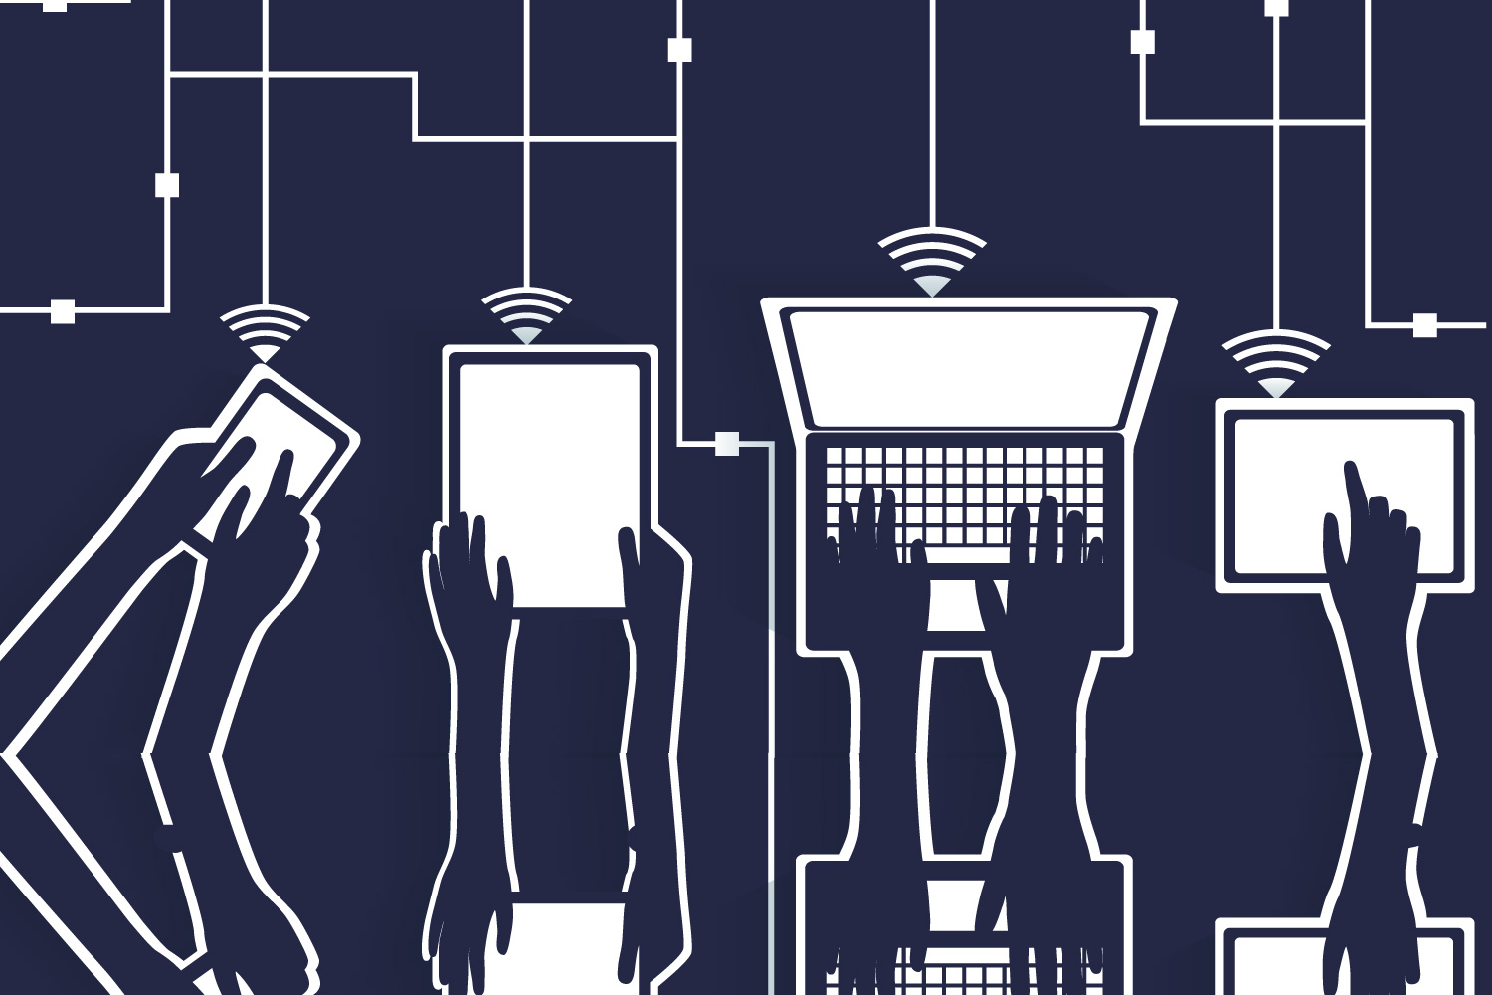


What is HTTPS?
Secure version of HTTP, uses TLS
Protocol that sends data between a web browser and website’s server
Internet Service Provider
Web Browser
Website Server
Encrypted
Encrypted
((Chapple & Seidl, 2021)

Slide 10
Full Disk Encryption
A method to encrypt all data in one’s storage devices which prevents access to data in the case that it was stolen or lost.
Uses symmetric encryption for bulk data and automatically encrypts files when being written to the disk.
Without a passphrase/secret key, encrypted storage devices will be unable to be read which may lead to data loss due to improper key storage.
((Chapple & Seidl, 2021)
Notes:
Email Security & Phishing Awareness
So now you've recongized a phishing email, the hard part is out of the way.
Delete and block the sending address

Slide 11
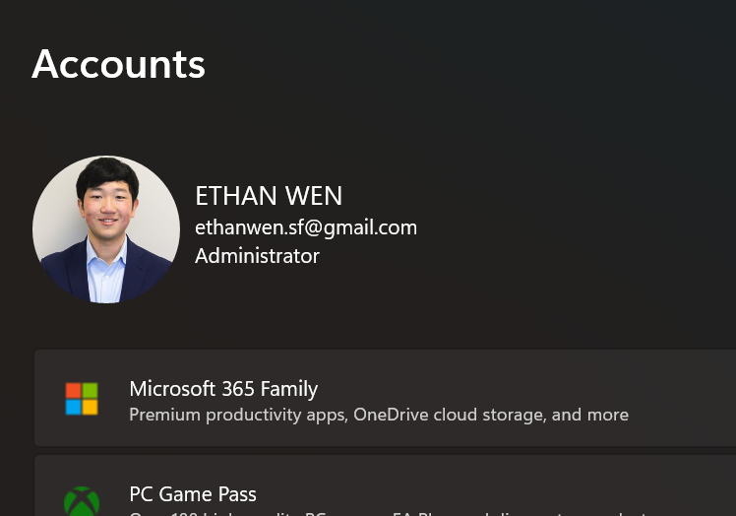
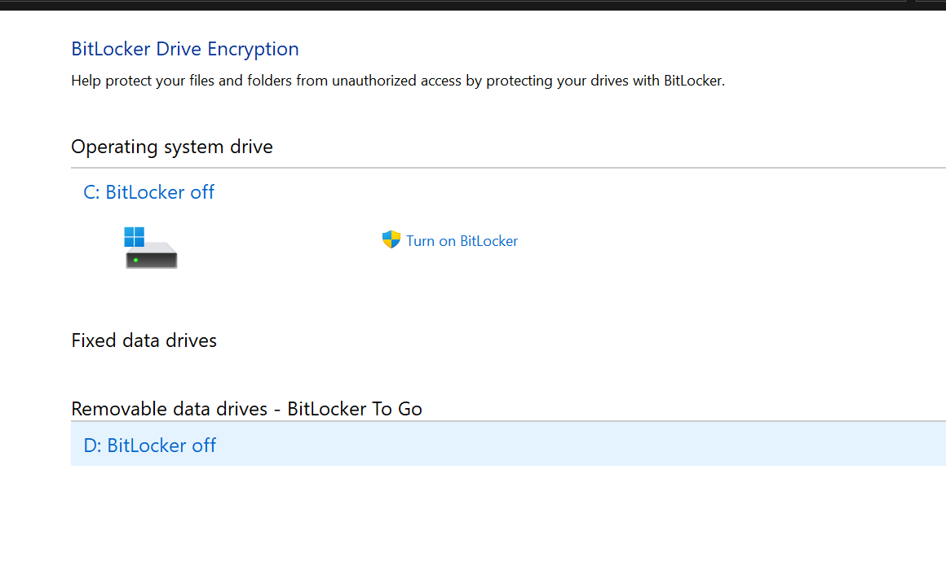
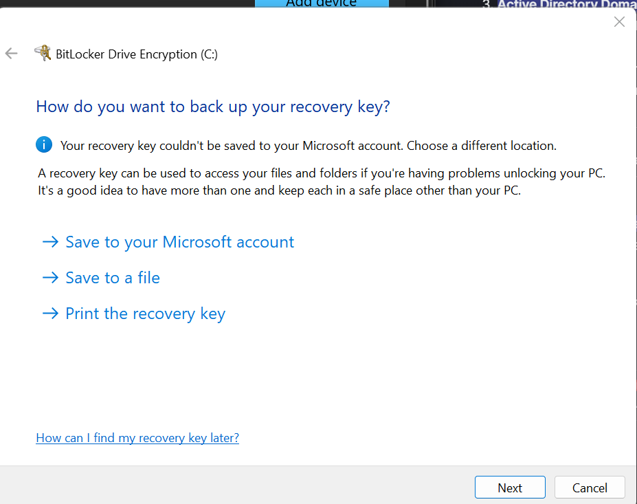
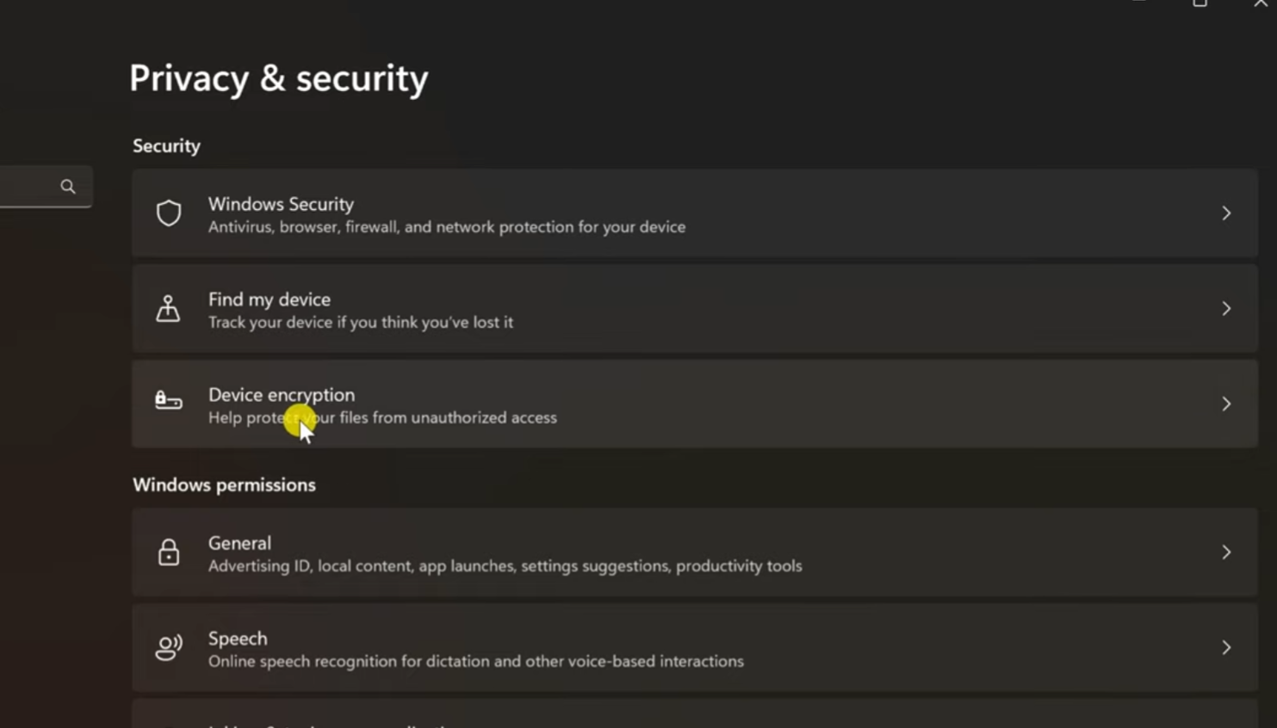
Turning on Full Disk Encryption for Windows
Device Encryption (Home)
BitLocker (Professional, Enterprise, Business)
BitLocker allows storage of recovery key in different locations (more features)
Administrator Account
Device Encryption (keys are tied to Windows Account/stored in OneDrive)
Store to local file/USB/password manager

Slide 12
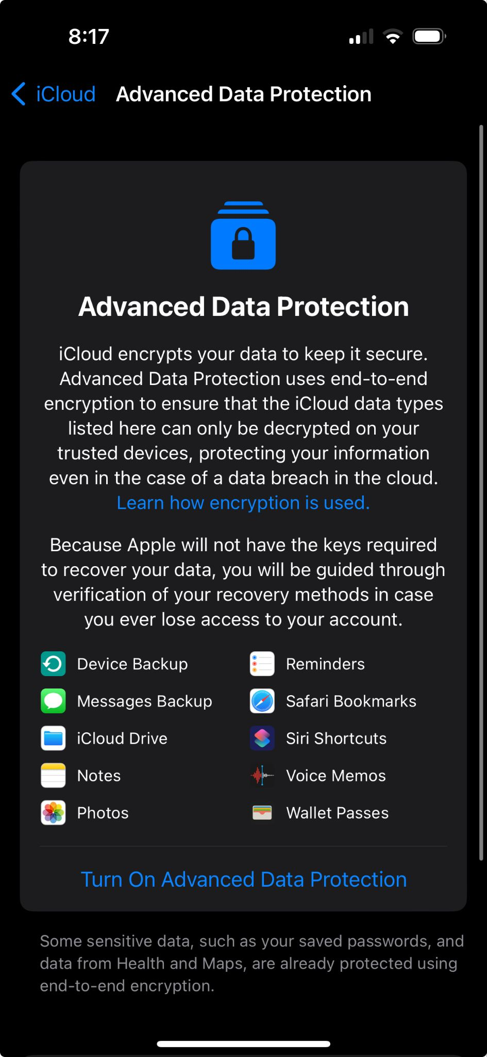
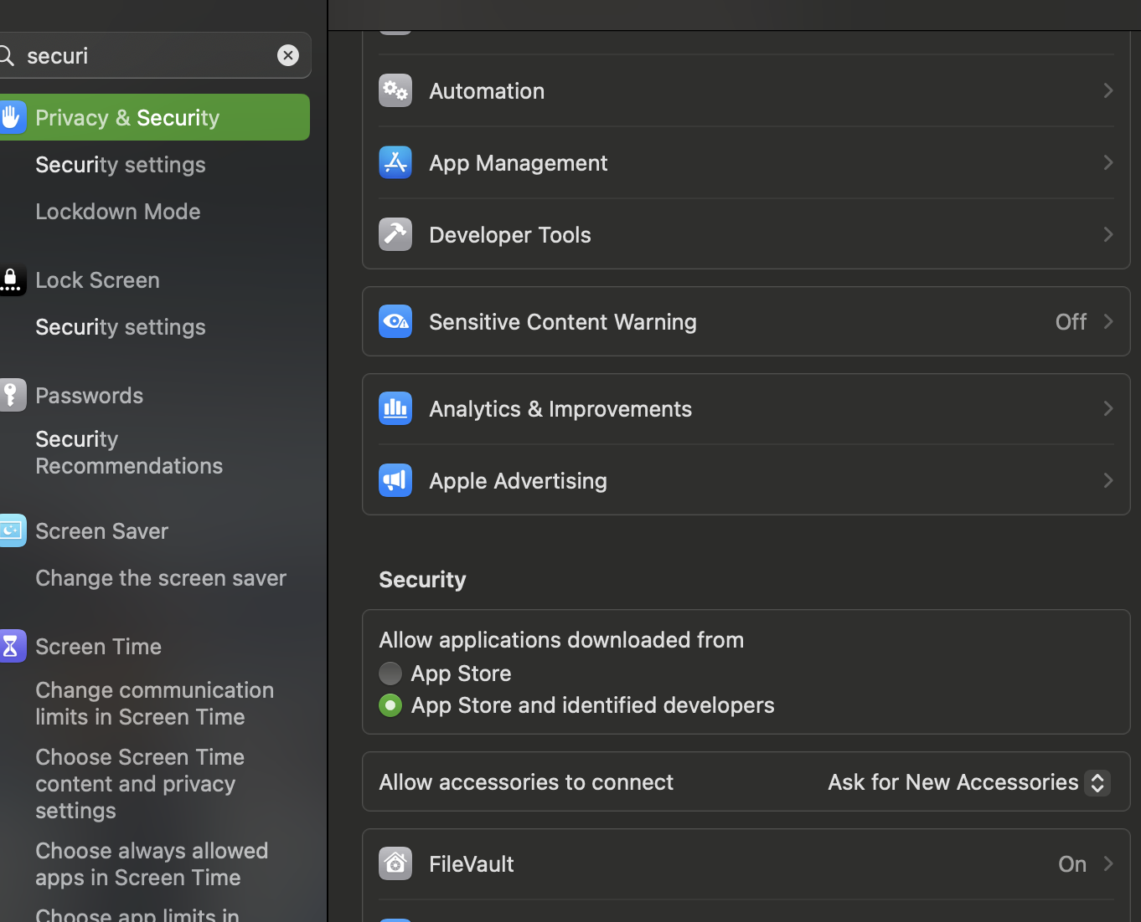
Turning on Full Disk Encryption for MacOS
FileVault
Optional setting that enables end-to-end encryption (specifically for iCloud backups)
FileVault - recovery key stored on a local file/iCloud/password manager

Slide 13
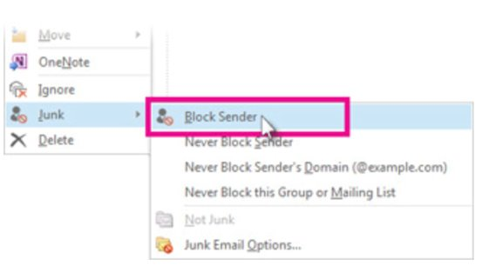
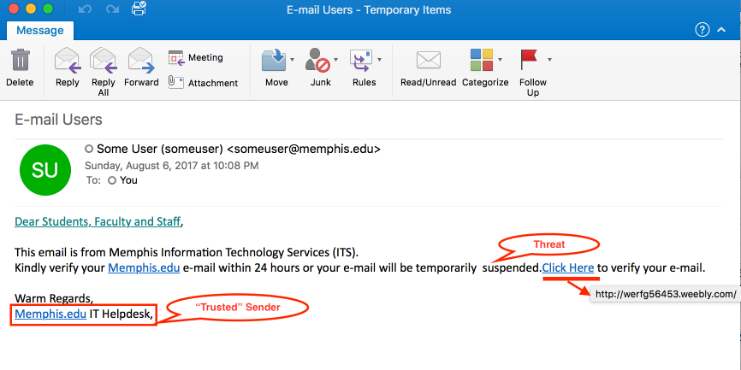
DO NOT automatically trust display names
1. Phishing Attempt
Read the Salutation
Hover over links to inspect link address
Check for contact information

Slide 14
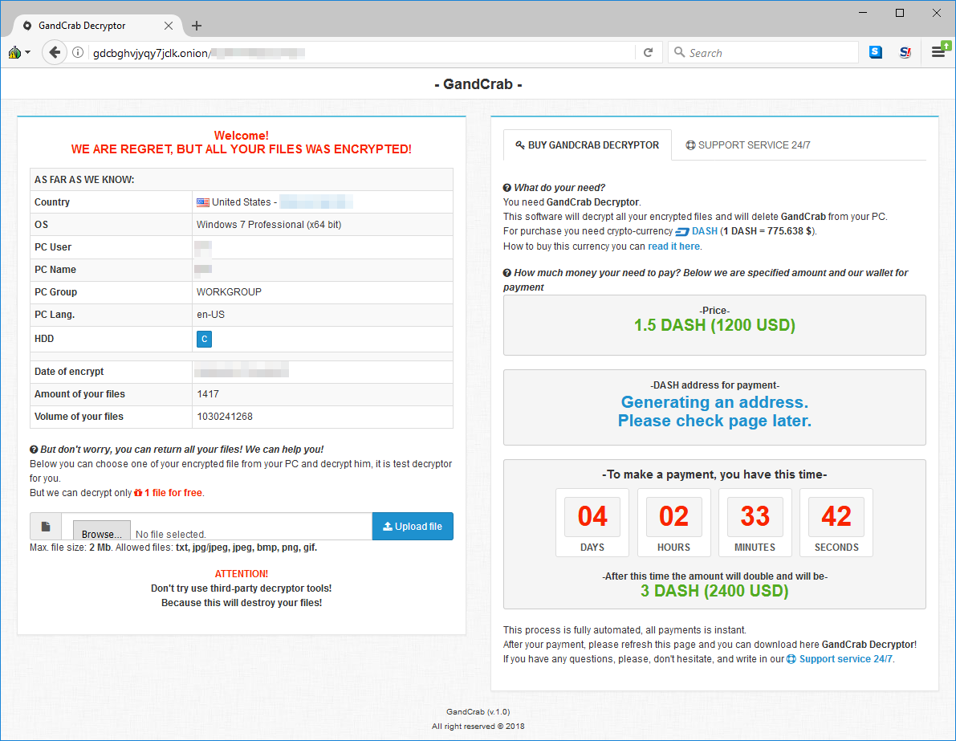
2. Ransomware Note

Slide 15
Ransomware
Prevent
>$1 Billion
Ransomware Payments in 2023
Install Antivirus
Update OS to patch vulnerabilities
Don’t open suspicious emails
Don’t click on links/download attachments
Avoid unfamiliar websites
Back up data to the cloud or external device
46%
Of Organizations who paid
61%
Of them got their data back
(Chainalysis Team, 2024), (Adam, W, 2022)

Slide 16


Recommendations – Instant Messaging
Signal Messenger
WhatsApp
(Global Cyber Alliance, 2020)

Slide 17

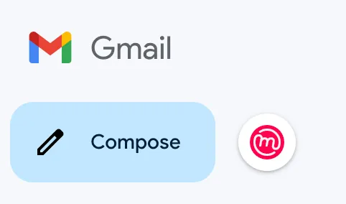
Recommendations – Email
Extension: Mailvelope
(Global Cyber Alliance, 2020)

Slide 18


Recommendations – Browsing
Brave Browser
Tor Browser
(Global Cyber Alliance, 2020)

Slide 19


Recommendations – VPN
Virtual Private Network creates an encrypted connection between a VPN provider’s server and the Internet Service Provider
Prevents ISP from viewing internet traffic
(Global Cyber Alliance, 2020)

Slide 20
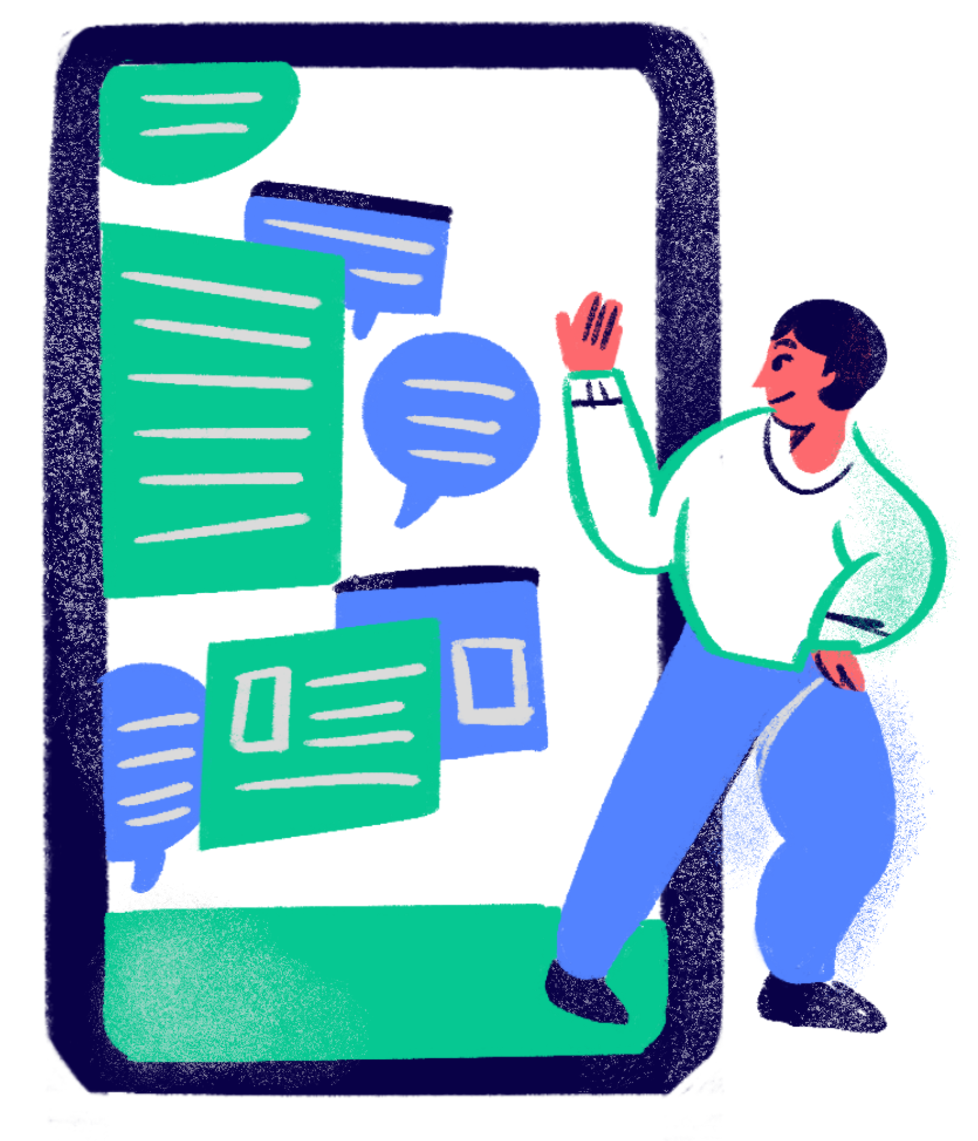
Ransomware Negotiation
Financial Times Ransomware Negotiation

Slide 21
Sources
Adam, W. by S. (2022, October 27). The state of ransomware 2022. Sophos News. https://news.sophos.com/en-us/2022/04/27/the-state-of-ransomware-2022/
Chainalysis Team. (2024, February 29). Ransomware hit $1 billion in 2023. https://www.chainalysis.com/blog/ransomware-2024/
Chapple, M., & Seidl, D. (2021). CompTIA Security+ SY0-601 Certification Study Guide. Sybex.
Cloudflare. (n.d.). What happens in a TLS handshake? https://www.cloudflare.com/learning/ssl/what-happens-in-a-tls-handshake/
mber 24). What should I know about encryption? Surveillance Self-Defense.
Electronic Frontier Foundation. (2018, Novehttps://ssd.eff.org/module/what-should-i-know-about-encryption
Global Cyber Alliance. (2020, October 6). Communicate securely - GCA Cybersecurity toolkit: Tools and resources to improve your cyber defenses. https://gcatoolkit.org/journalists/communicate-securely/?_tk=secure-your-browsing
Resources
Device Encryption/Bitlocker
FileVault
GCA Toolkit

Slide 22

THANK YOU !

